Slide 1
Number Systems

Slide 2
Understanding the digits of a number system
Conversions between decimal and binary, decimal and hexadecimal, and binary and hexadecimal.
a decimal (base 10) number is constructed with 10 digits: 0 through 9. The first digit in any numbering system is always zero.
For example, a base 8 (octal) number contains 8 digits: 0 through 7; a base 2 (binary) number contains 2 digits: 0 and 1.
If the base of a number exceeds 10, the additional digits use the letters of the alphabet, beginning with an A.
For example, a base 12 number contains 10 digits: 0 through 9, followed by A for 10 and B for 11.

Slide 3
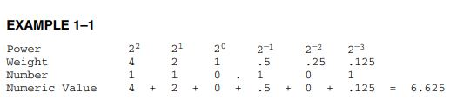
larger numbers are constructed by using positional notation
The units position has a weight of 10⁰, or 1; the tens position has weight of 10¹, or 10; and the hundreds position has a weight of 10², or 100. The exponential powers of the positions are critical for understanding numbers in other numbering systems.

Slide 4
In the decimal system, positions to the right of the decimal point have negative powers. The first digit to the right of the decimal point has a value of 10-1, or 0.1.
In the binary system the first digit to the right of the binary point has a value of 2-1, or 0.5.
In general, the principles that apply to decimal numbers also apply to numbers in any other number system.

Slide 5
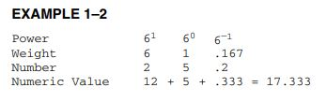
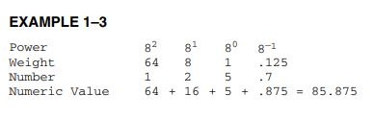
to convert from any number base to decimal, determine the weights or values of each position of the number, and then sum the weights to form the decimal equivalent

Slide 6
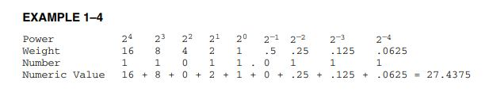
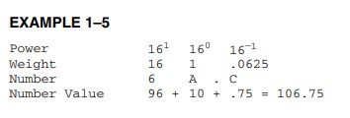

Slide 7
Whole Number Conversion from Decimal.
Divide the decimal number by the radix (number base).
Save the remainder (first remainder is the least significant digit).
Repeat steps 1 and 2 until the quotient is zero.

Slide 8
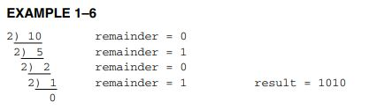
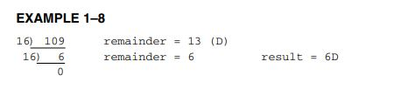
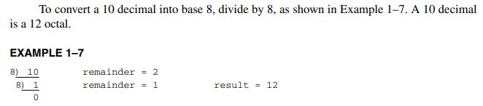
to convert a 10 decimal to binary, divide it by 2
The result is written as 10102 from the bottom to the top.

Slide 9
Converting from a Decimal Fraction.
An algorithm for conversion from a decimal fraction is as follows:
1. Multiply the decimal fraction by the radix (number base).
2. Save the whole number portion of the result (even if zero) as a digit. Note that the first result is written immediately to the right of the radix point.
3. Repeat steps 1 and 2, using the fractional part of step 2 until the fractional part of step 2 is zero.

Slide 10
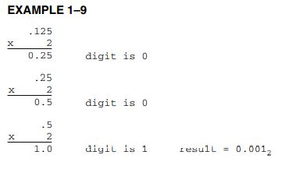
A .125 decimal is converted to binary.
This is accomplished with multiplication by 2
the multiplication continues until the fractional remainder is zero.
The whole number portions are written as the binary fraction (0.001) in this example.

Slide 11


Slide 12
Binary-coded hexadecimal (BCH) is used to represent hexadecimal data in binary code.
A binary-coded hexadecimal number is a hexadecimal number written so that each digit is represented by a 4-bit binary number.
Hexadecimal numbers are represented in BCH code by converting each digit to BCH code with a space between each coded digit.

Slide 13
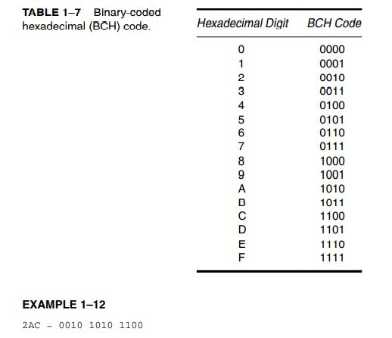

Slide 14
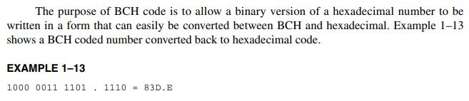

Slide 15
Complements
At times, data are stored in complement form to represent negative numbers. There are two systems that are used to represent negative data:
radix
radix - 1 complements
The earliest system was the radix -1 complement, in which each digit of the number is subtracted from the radix -1 to generate the radix -1 complement to represent a negative number

Slide 16
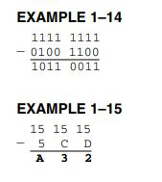
1s complement and 15s complement

Slide 17
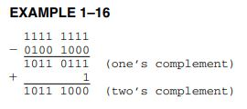
To form the radix complement, first find the radix -1 complement, and then add a one to the result.
To prove that a 0100 1000 is the inverse (negative) of a 1011 1000, add the two together to form an 8-digit result.
The ninth digit is dropped and the result is zero because a 0100 1000 is a positive 72, while a 1011 1000 is a negative 72.
The same technique applies to any number system.

Slide 18
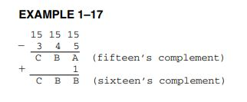
The inverse of a 345 hexadecimal is found by first fifteen’s complementing the number, and then by adding one to the result to form the sixteen’s complement.
As before, if the original 3-digit number 345 is added to the inverse of CBB, the result is a 3-digit 000.
As before, the fourth bit (carry) is dropped.
This proves that 345 is the inverse of CBB.

